Slide 1



Spartacus Training Day 4

Slide 2

Recap.
Spartacus Training Day 4
We have learn first step of customization in the form of outlets.
Now in this session we are going to learn on how to customize the CMS components in Spartacus application.

Slide 3
Get Spartacus Repo With you.
Spartacus Training Day 4
Clone Spartacus repo using : git clone https://github.com/SAP/spartacus.git
Or Download using https://github.com/SAP/spartacus

Slide 4
Custom CMS Components
Spartacus Training Day 4
Goals
Understand how pages get rendered
Understand CMS component mapping
Understand access to CMS data
Create custom component
Topics
Configure Custom Component
Accessing CMS Data in Custom Components
CMS Component Types
Render CMS Components “manually”
SSR Aware Components

Slide 5
Rendering Process
Spartacus Training Day 4
Page rendering process is CMS based.
Backend does not provide all the information required to render a page.
Some part of configuration is stored in Layout Configuration (.ts file).
Layout config contains information about page templates and slots within them.
Slots contain CMS components.
Information about components attached to slots comes from the backend.
CMS components are mapped to Angular Components via component mapping.

Slide 6
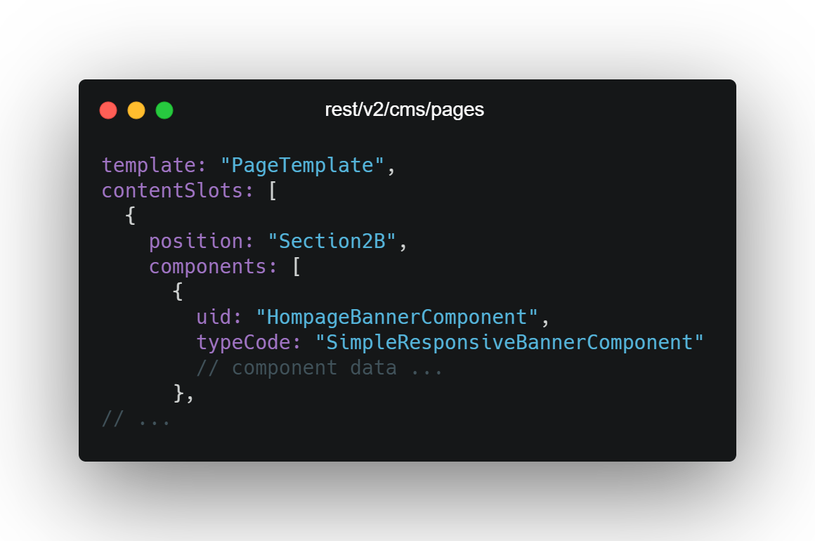
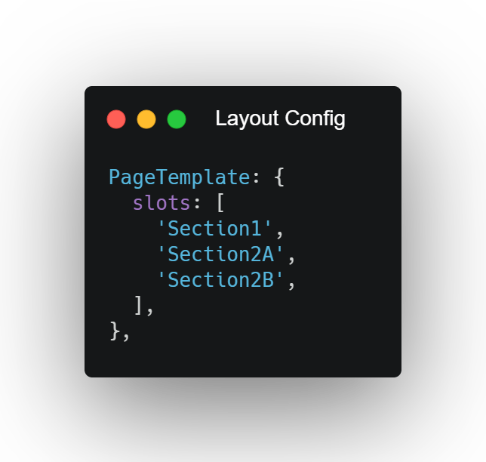
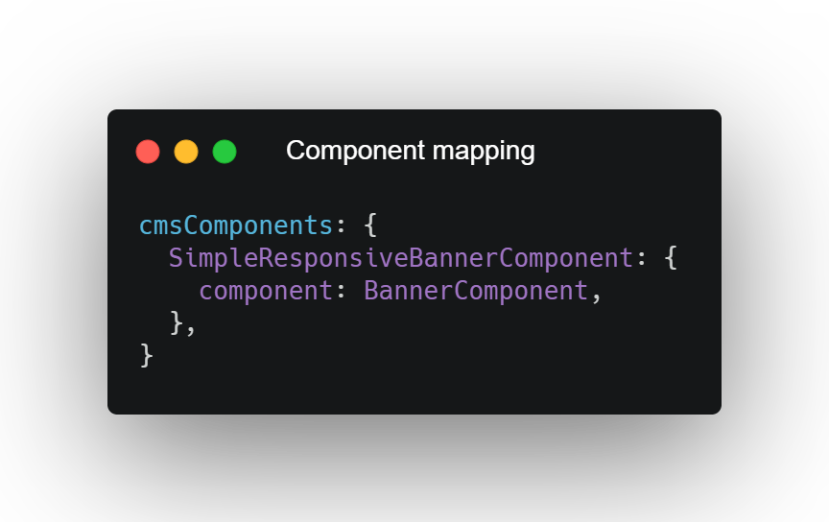
Rendering Process
Spartacus Training Day 4

Slide 7
Configure Custom Component
Spartacus Training Day 4
Creating a Module.
Map A CMS Component To Angular Component
ConfigModule.withConfig({
cmsComponents: {
BannerComponent: {
component: CustomBannerComponent
}
} as CmsConfig
})
type code
component class

Slide 8
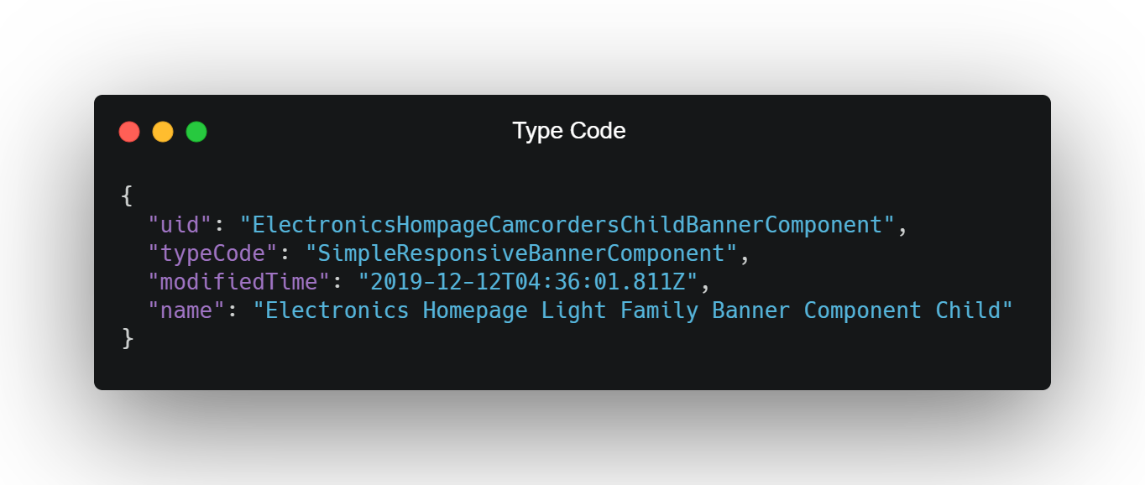
CMS Component Types
Spartacus Training Day 4
This Type of components are the most common ones.
You can use typeCode to map components with frontend.

Slide 9
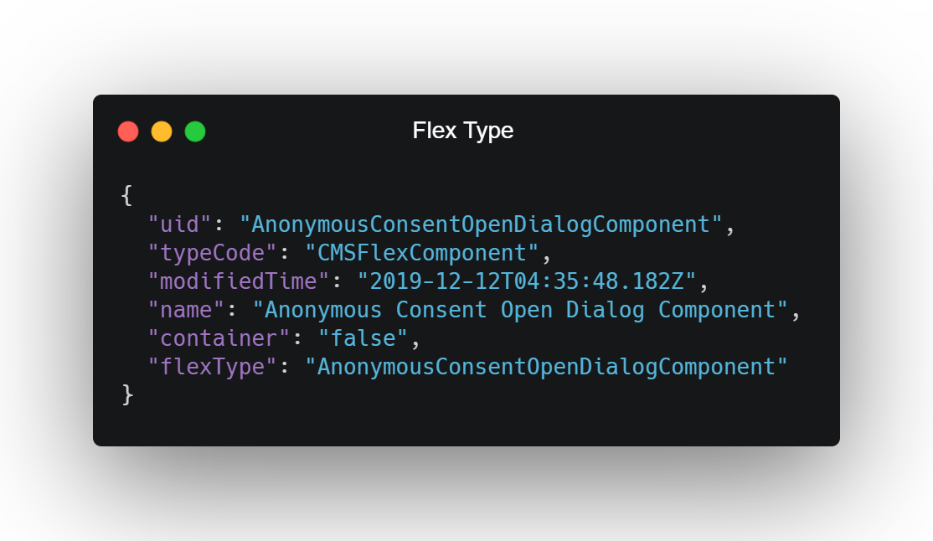
CMS Component Types
Spartacus Training Day 4
These components are mapped based on flexType. Also called as flex components or JSPIncludedComponents.

Slide 10
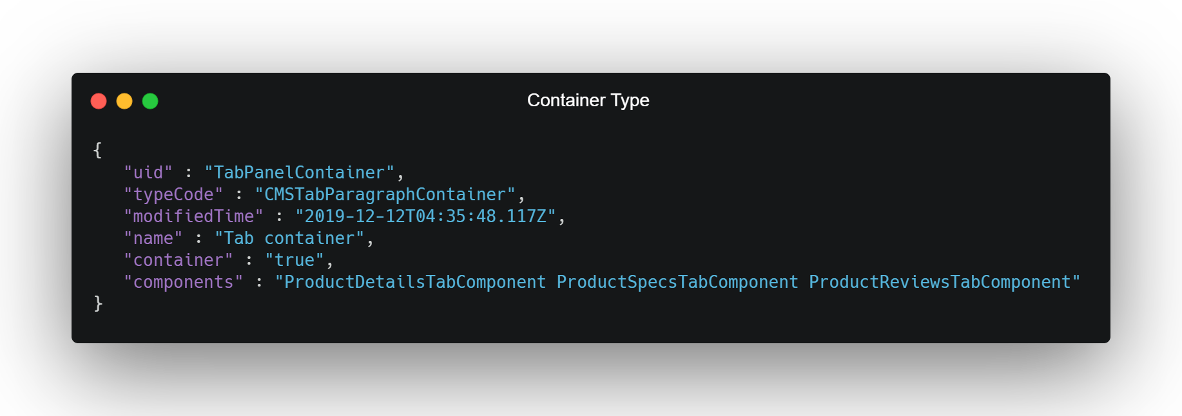
CMS Component Types
Spartacus Training Day 4
We can have container components which can contain more than one components. It works as a wrapper to all components which are inside.

Slide 11
Resources
Spartacus Training Day 4
Documentation https://sap.github.io/cloud-commerce-spartacus-storefront-docs/customizing-cms-components/

Slide 12
Exercise
Spartacus Training Day 4
In PDP Display Change price from $XX to USD $ XX. Display Manufacturer name also.
Replace the cart details section of the cart page. Our new cart details should display the list of cart item names and prices. Don’t worry about allowing customers to edit the cart, just display the cart content in the simplest way. Tip: use ActiveCartService

Slide 13
Thank you !

